Slide 1
Data Centers
Design, Architecture, and Tier Levels

Slide 2
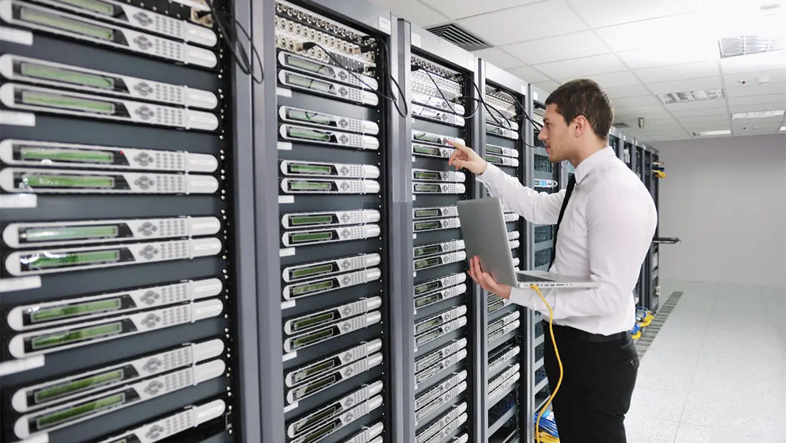

Slide 3
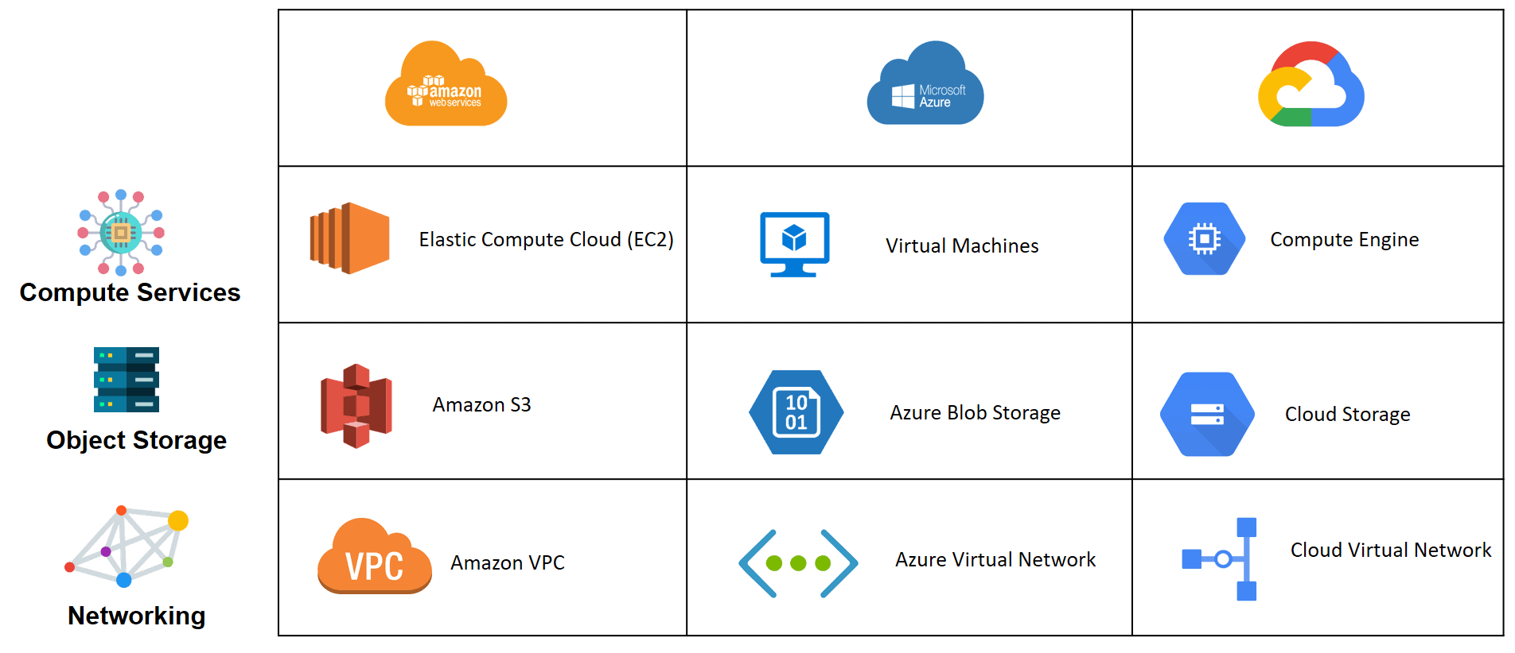

Slide 4
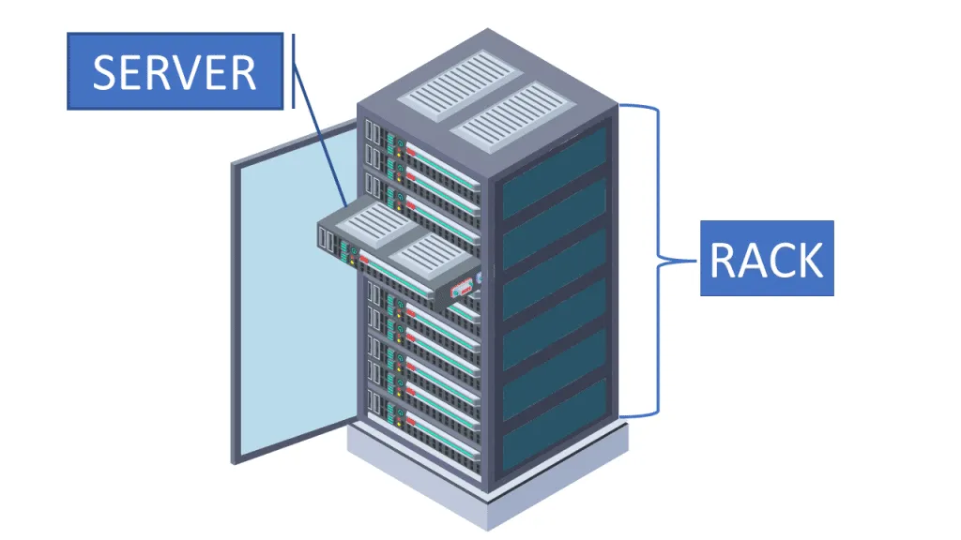
Data Centers
Data Center: A data center is a facility used to house computer systems and associated components, such as telecommunications and storage systems.
Purpose:
Centralized management of IT resources
Support for critical applications
High availability and redundancy

Slide 5
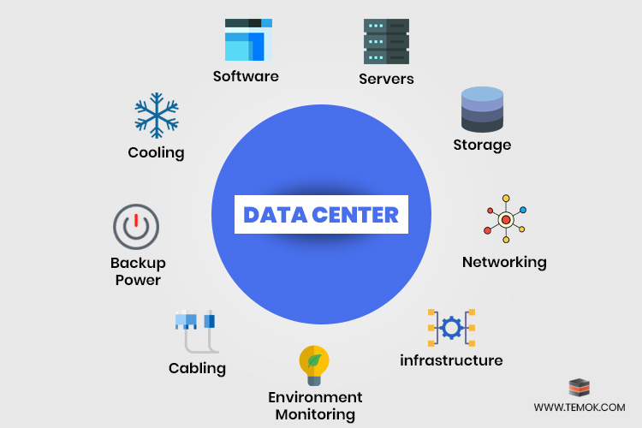
Key Components:
Key Components:
Servers
Storage Systems
Networking Equipment
Cooling Systems
Power Supply Units
Security Systems
Interdependence: Efficient operation relies on seamless integration of these components.

Slide 6
Data Center Design Principles
Scalability: Design for future growth.
Redundancy: Minimize single points of failure.
Efficiency: Optimize power and cooling.
Security: Physical and virtual protection.
Sustainability: Eco-friendly solutions.

Slide 7
Data Center Architecture
Layers:
Physical Layer: Hardware and infrastructure
Virtual Layer: Virtualized servers and networks
Application Layer: Software and services
Topology:
Star
Mesh
Leaf-Spine

Slide 8
Power Efficiency in Data Centers
Key Metrics:
PUE (Power Usage Effectiveness): Ratio of total facility energy to IT equipment energy.
DCiE (Data Center Infrastructure Efficiency): Inverse of PUE.
Techniques to Improve Efficiency:
Energy-efficient hardware
Liquid cooling systems
Renewable energy sources

Slide 9
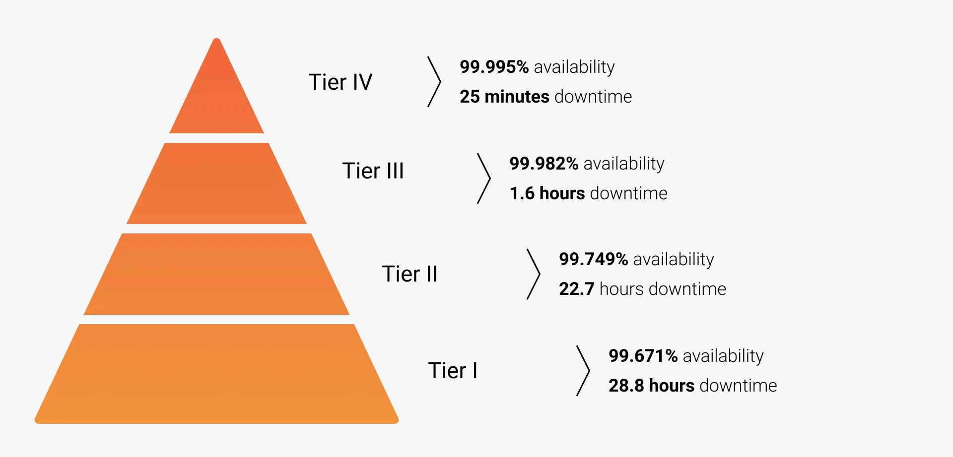
Tier Levels of Data Centers
Classification system based on uptime and redundancy.
Tiers:
Tier I: Basic Capacity (No redundancy)
Tier II: Redundant Capacity
Tier III: Concurrently Maintainable
Tier IV: Fault-Tolerant (Fully redundant systems)

Slide 10
Data Center Security
Aspects:
Physical Security: CCTV, access control
Cybersecurity: Firewalls, encryption
Disaster Recovery: Backup and replication
Importance: Protect data integrity and availability.

Slide 11
Sustainability in Data Centers
Challenges: High energy consumption.
Solutions:
Use of renewable energy.
Efficient cooling systems.
Green certifications (LEED, Energy Star).

Slide 12
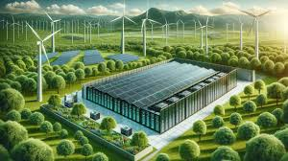
Case Study: Efficient Data Center Design
Google’s Data Centers
Techniques: AI-based cooling, renewable energy use.
Outcome: Significant energy savings.

Slide 13
Summary
Data centers are critical for modern IT infrastructure.
Design and efficiency directly impact performance and sustainability.
Understanding tier levels helps in planning for required uptime and redundancy.

